Slide 1
Read Recommend: Progressive Demo A
Team : Fab5
Rong Zhang (z3456421)
Vandhana Visakamurthy (z5222191)
Yiligong (z5199285)
Yu Han (z5219071)
Yuehui Chu (z5180907)

Slide 2
Objective
What is Read Recommend all about ?
Read Recommend is a platform for users to find books and keep track of books they’ve read.
It is a one stop solution for readers to find new books to read based on their collections and to keep track of all read books using collections.
It is also a platform for readers to find other like minded readers and browse through their collections.
Read Recommend is also a platform for readers to rate and review books based on their experience.

Slide 3
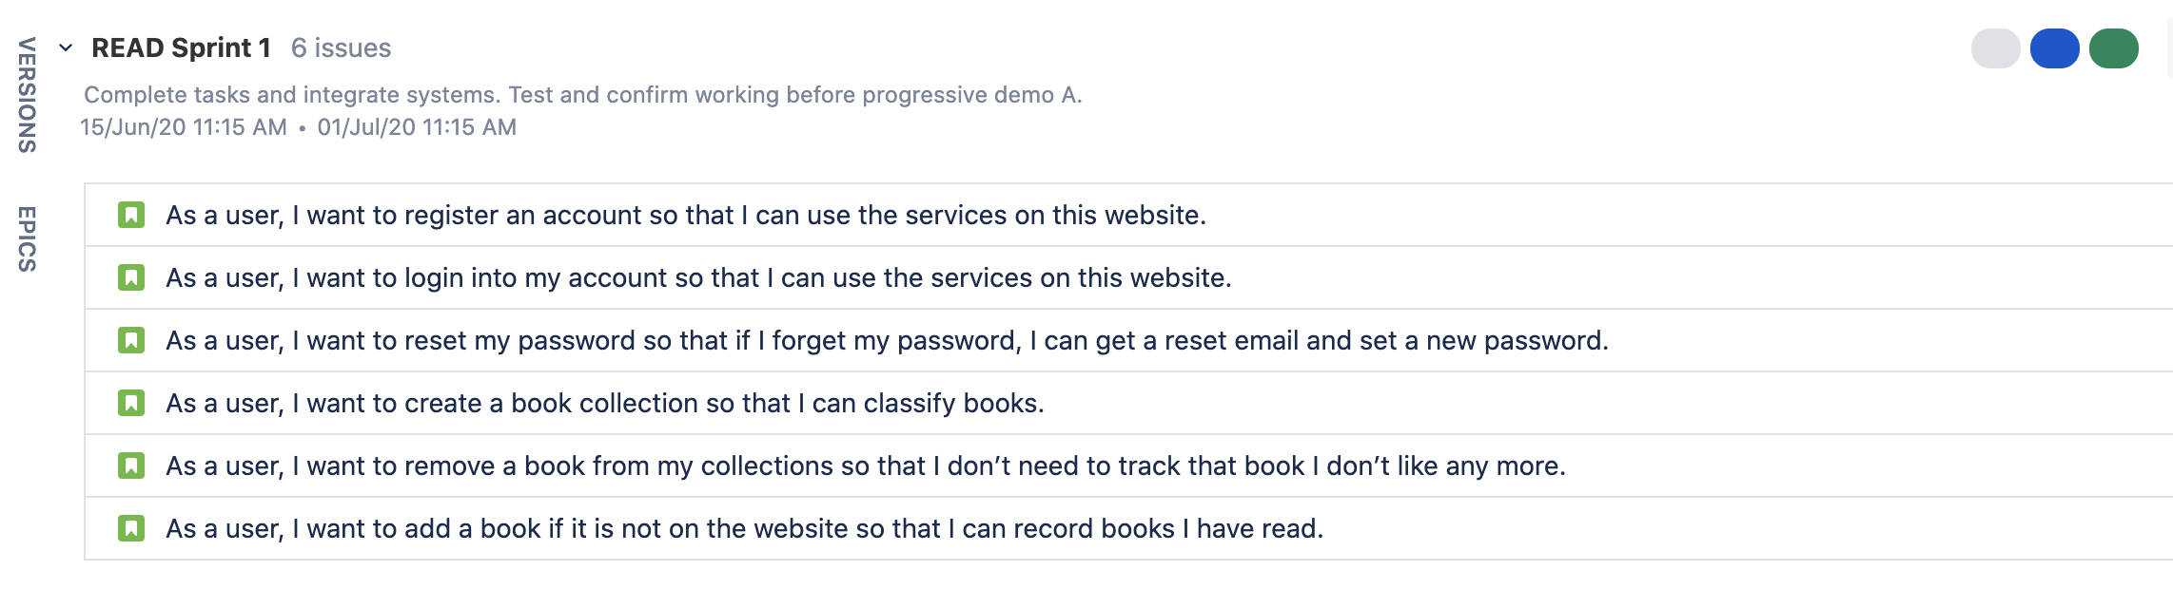
Initial Sprint
The initial sprint consists of six user stories that had to be implemented over the duration of two weeks.
Sprint Start : 15.06.2020
Sprint End : 01.07.2020

Slide 4
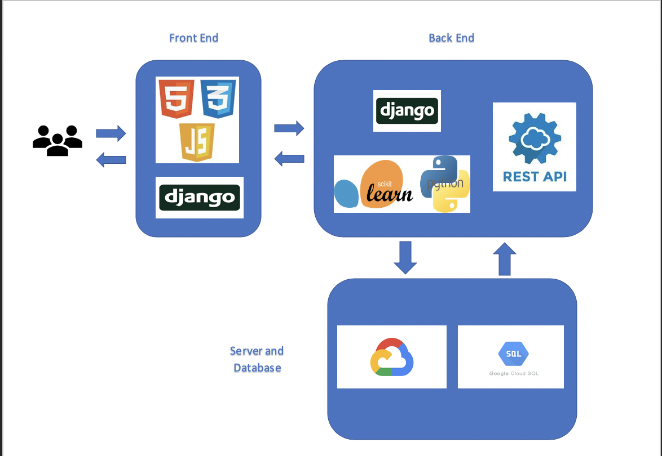
Architecture

Slide 5
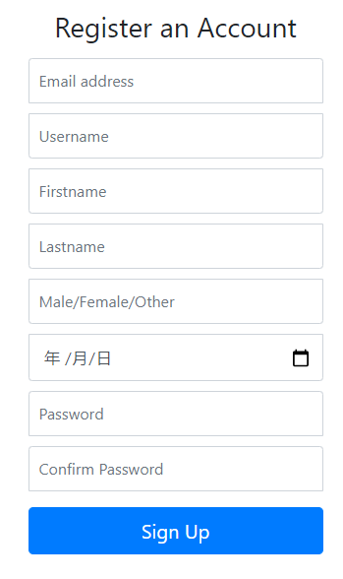
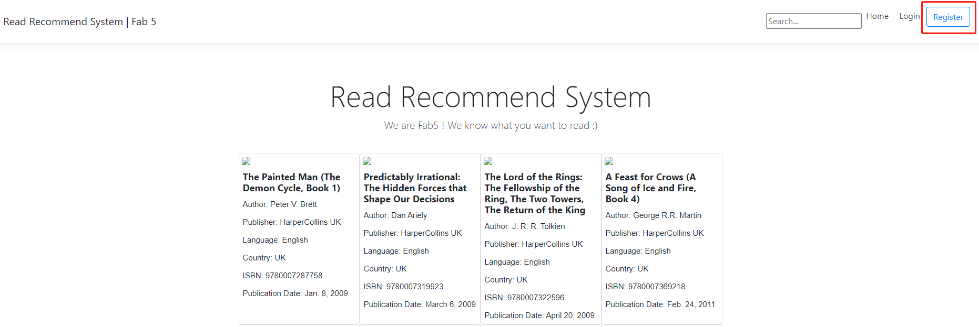
User Story 1
As a user, I want to register an account so that I can use the services on this website.

Slide 6
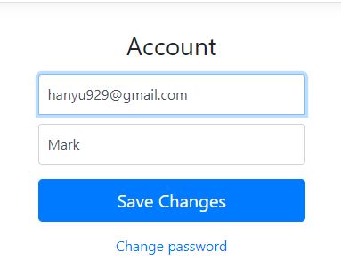
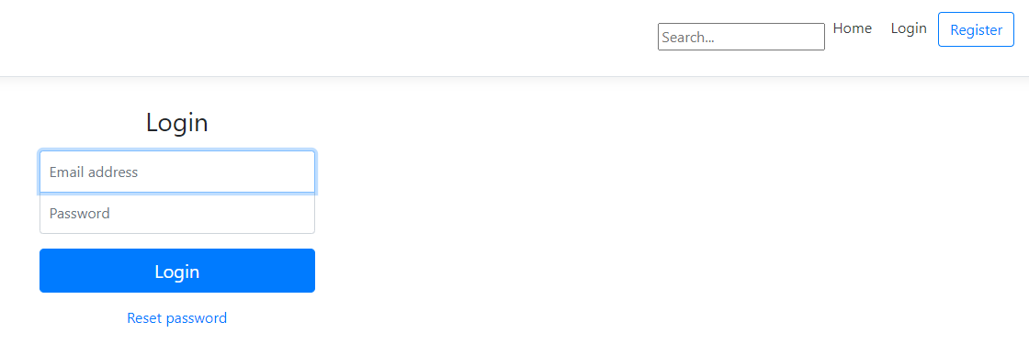
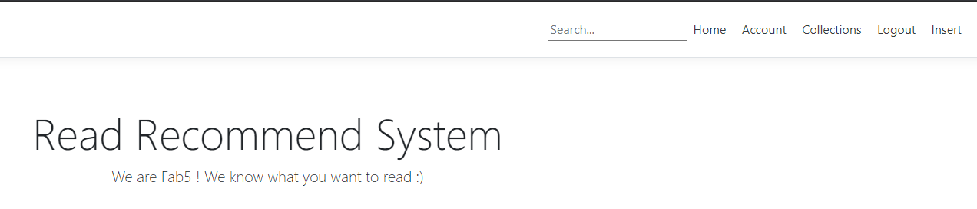
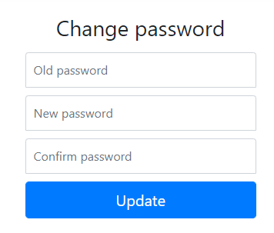
User Story 2
As a user, I want to login into my account so that I can use the services on this website.

Slide 7
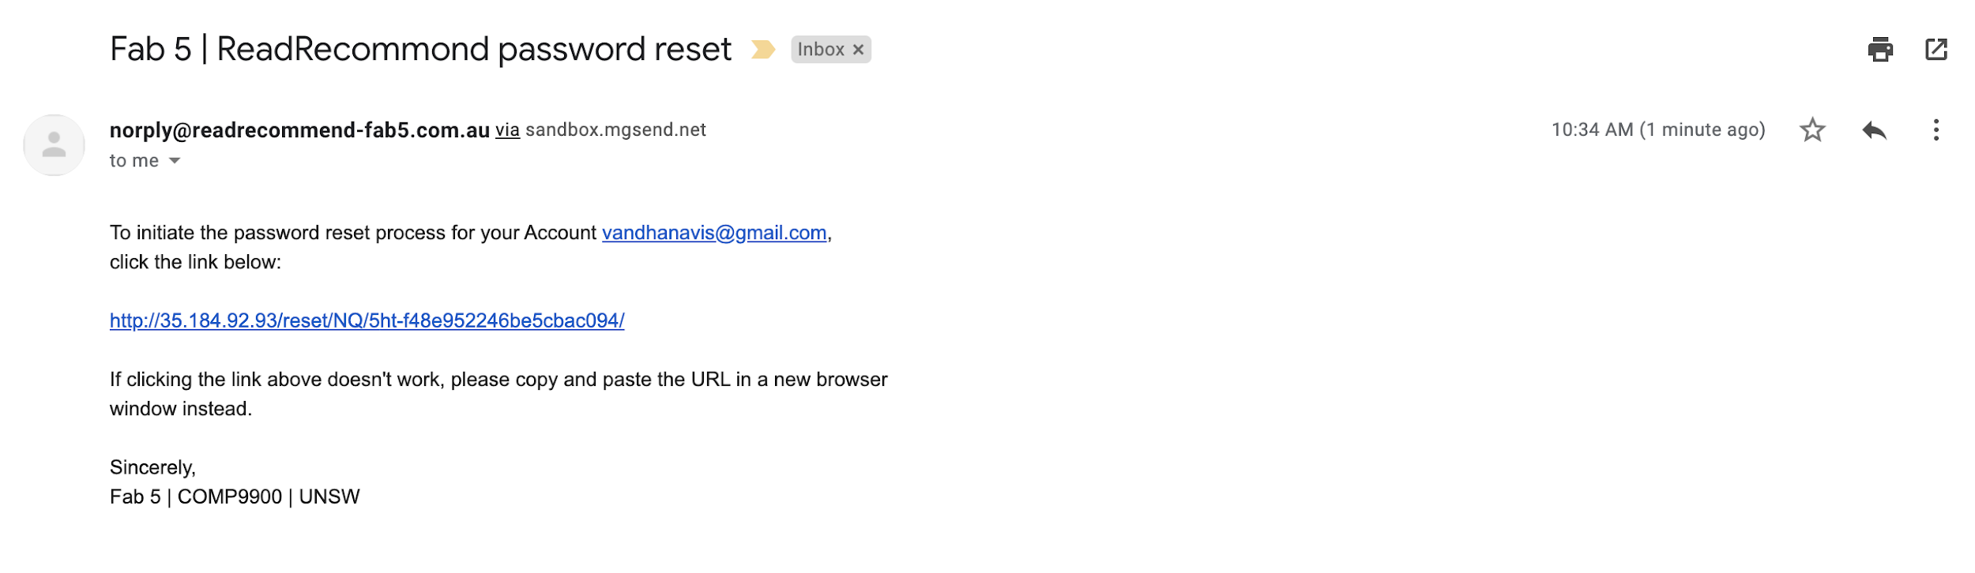
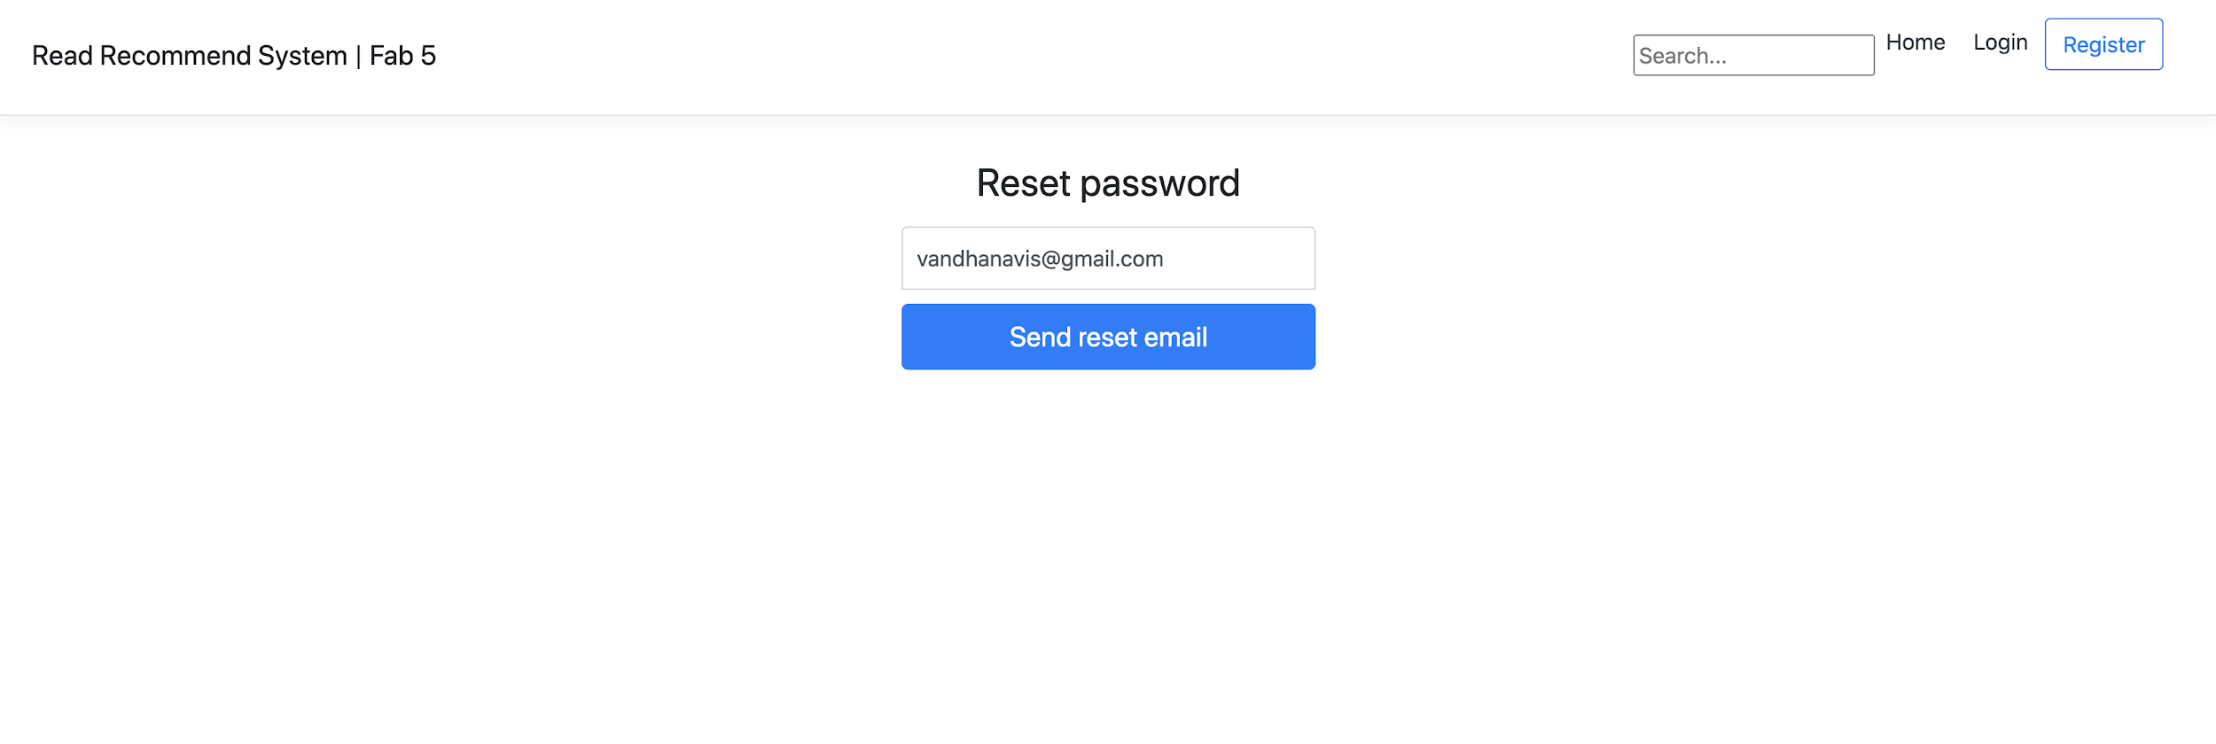
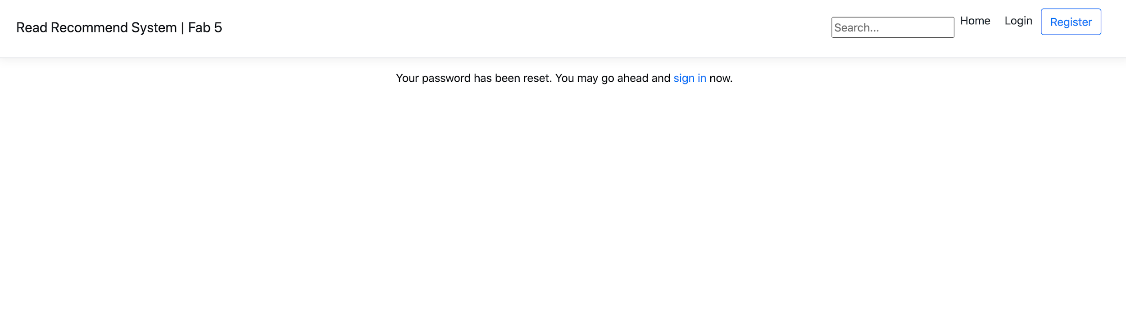
User Story 3
As a user, I want to reset my password so that if I forget my password, I can get a reset email and set a new password.

Slide 8
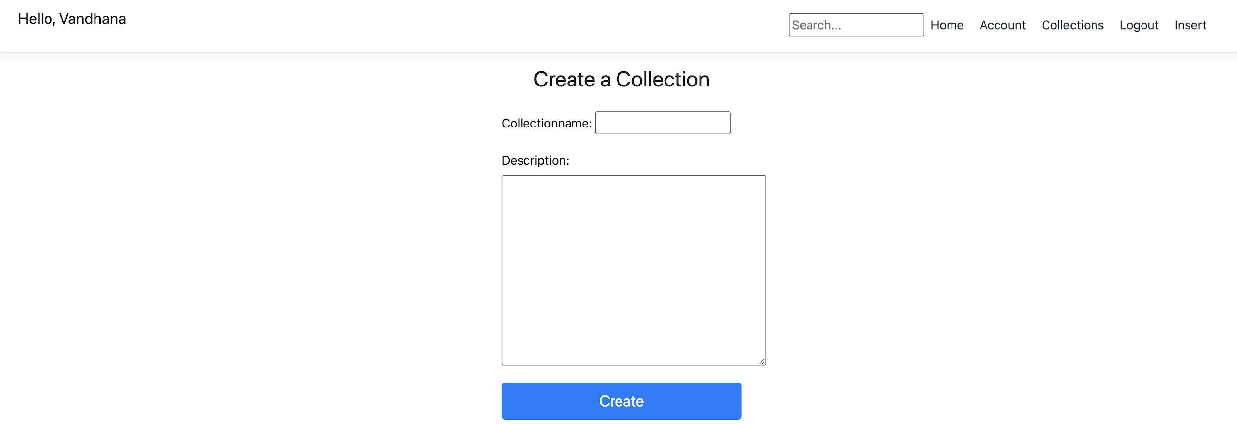
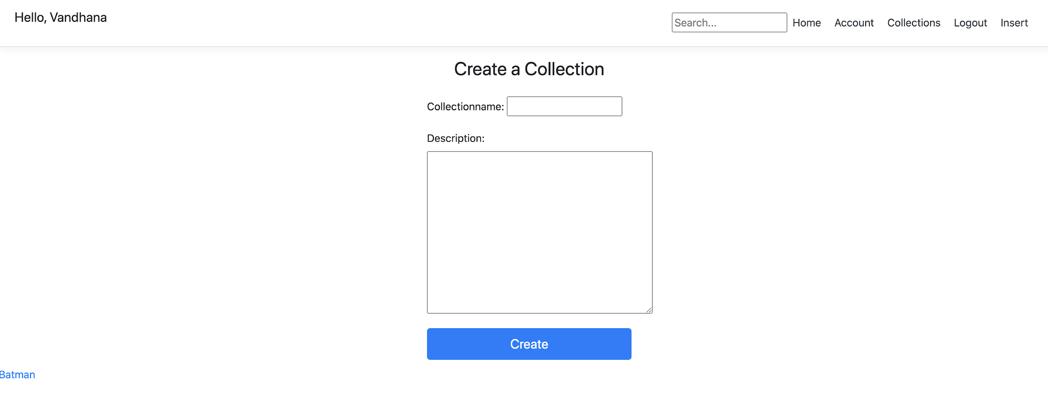
User Story 4
As a user, I want to create a book collection so that I can classify books.
Batman

Slide 9
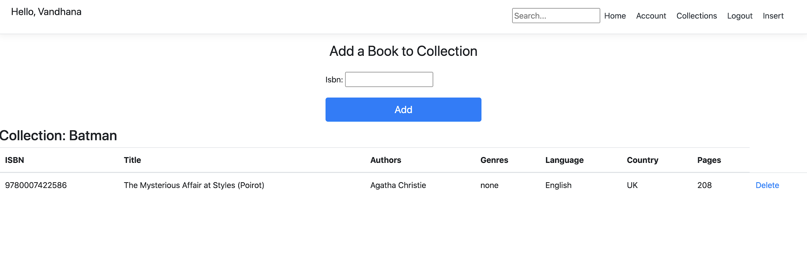
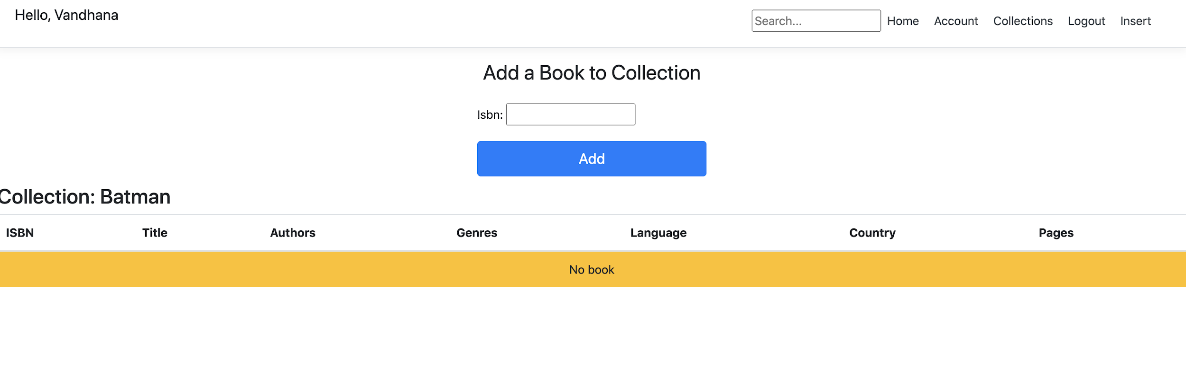
User Story 5
As a user, I want to remove a book from my collection so that I don’t need to track that book I don’t like any more.

Slide 10
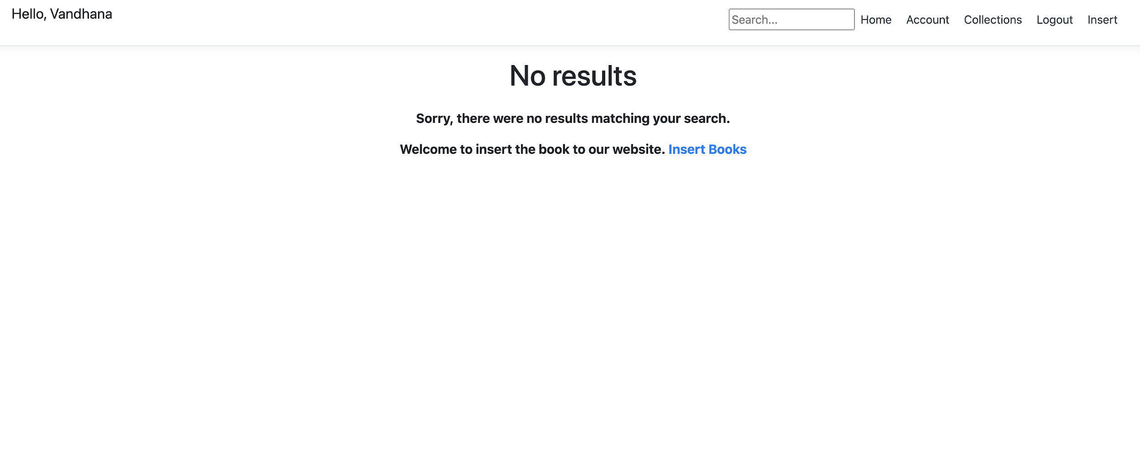
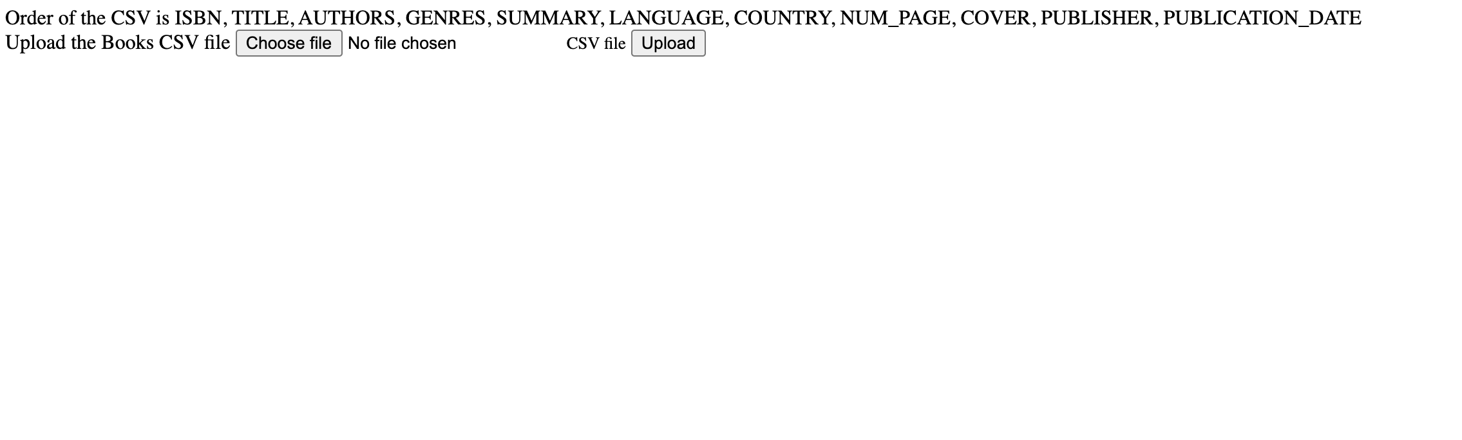
User Story 6
As a user, I want to add a book if it is not on the website so that I can record books I have read.
Notes:
UI for add books, As a reader

Slide 11
Demo
Live Demo
Live Demo Link:
http://35.184.92.93/

Slide 12
JIRA SPRINT BOARD
How we made progress in the initial sprint ?

Slide 13
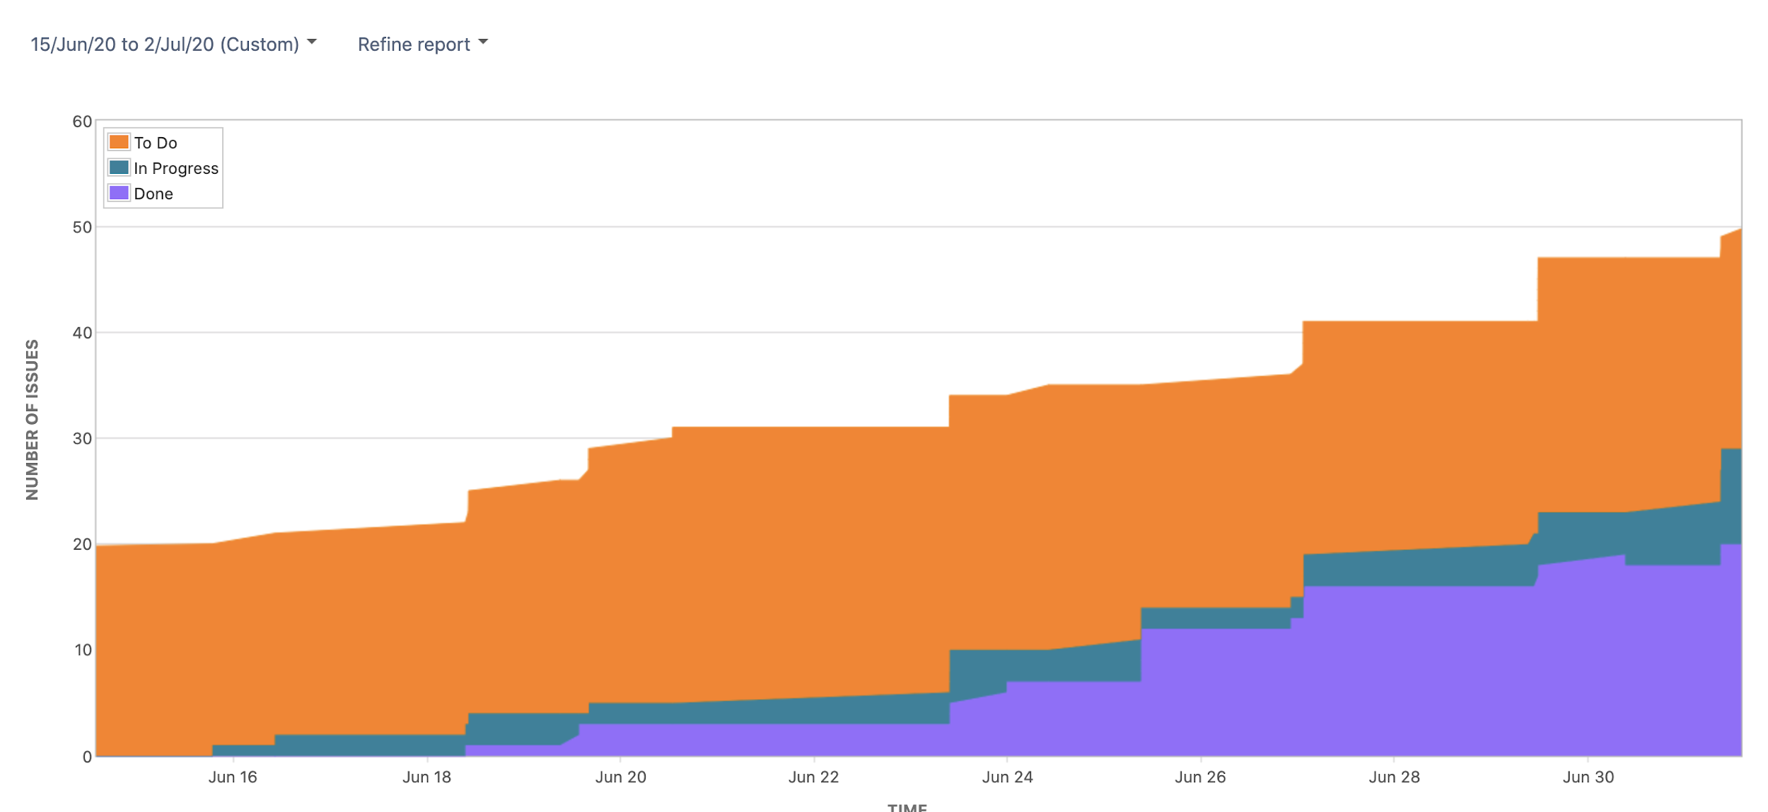
Visual Report
Cumulative Flow Diagram

Slide 14
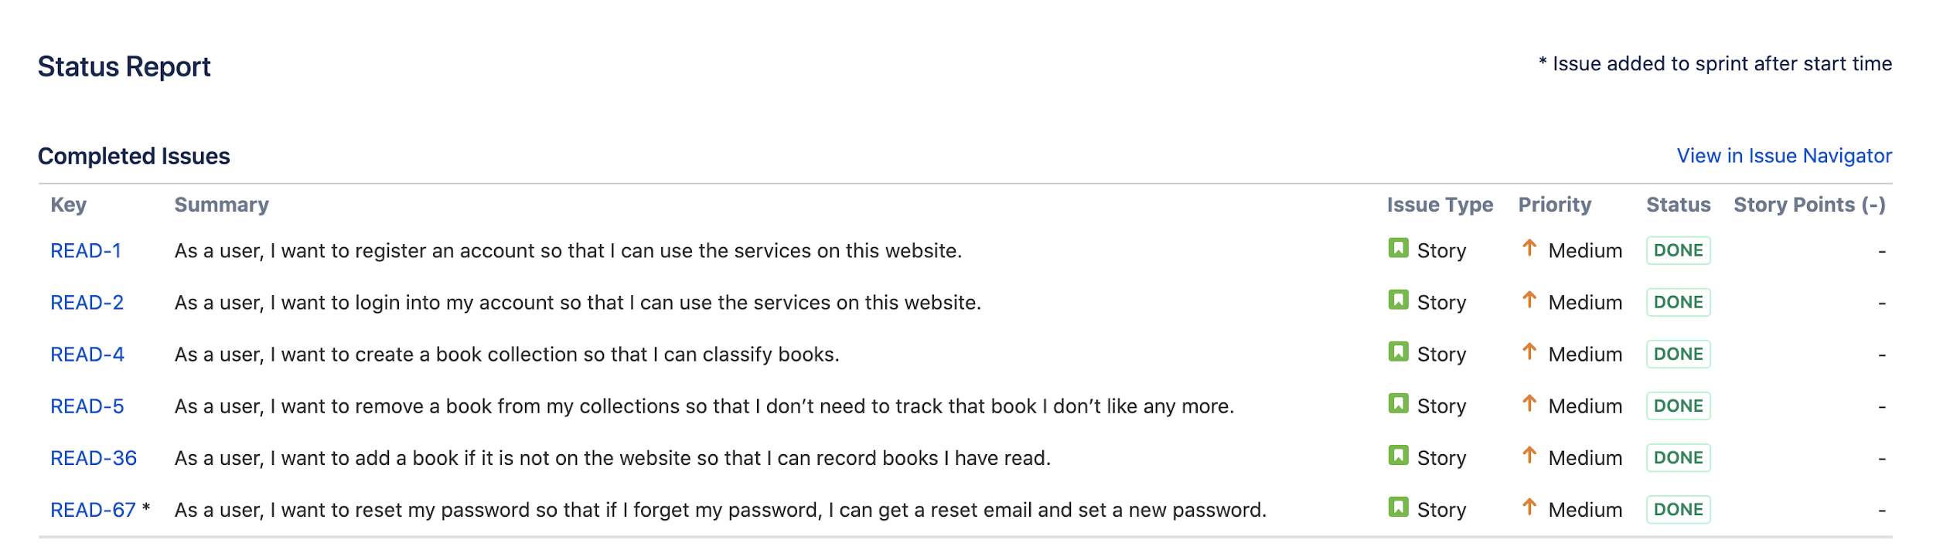
Jira User Story Status
Did we complete all user stories ?
YES

Slide 15
Thank you!

